Slide 1
CDI Resolución de Ejercicios

Slide 2
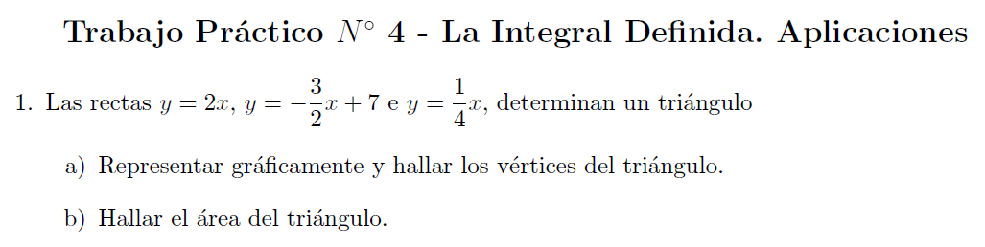

Slide 3


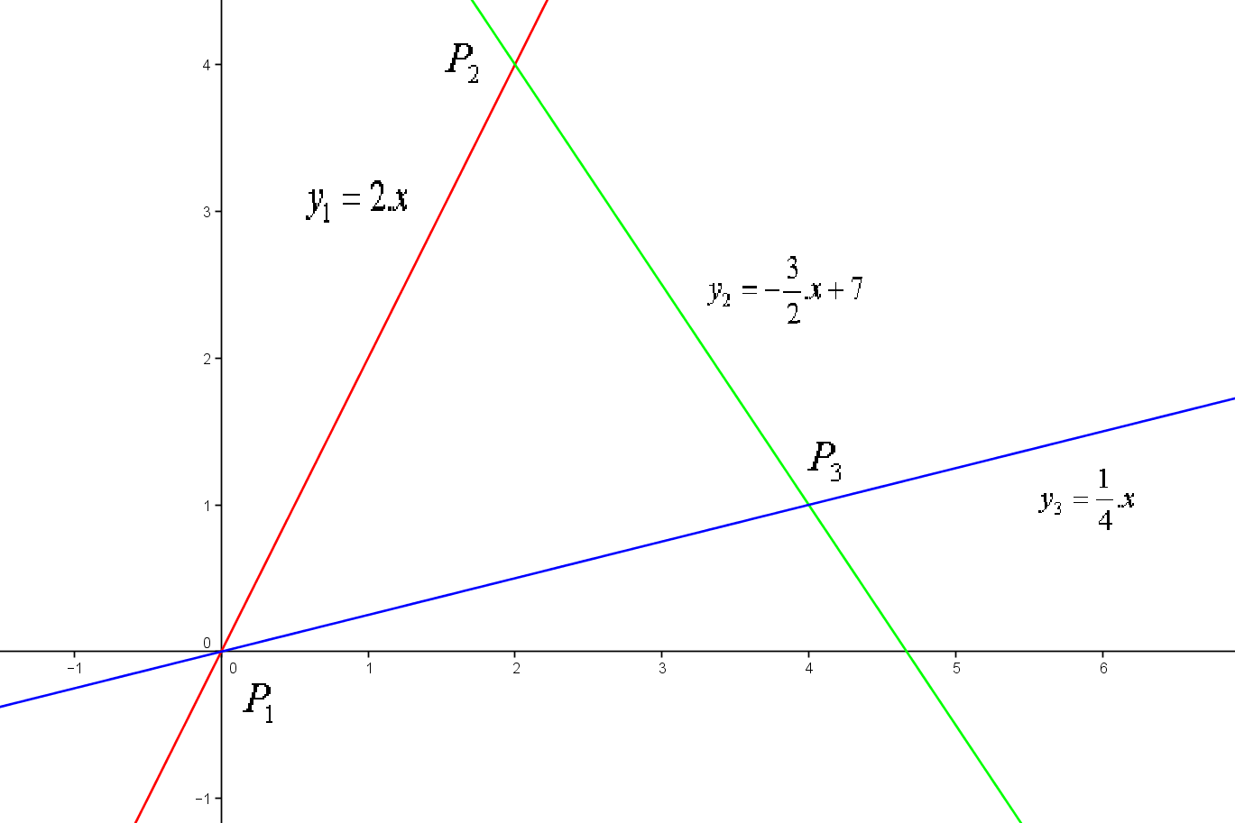








Intersección entre las rectas
Puntos

Slide 4
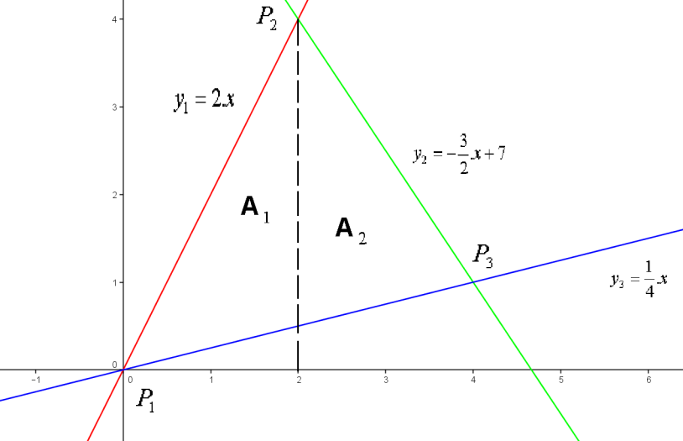

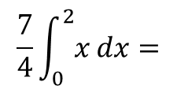
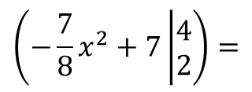
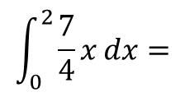
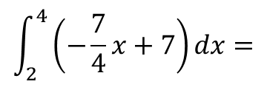
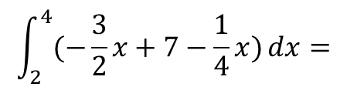
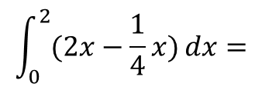
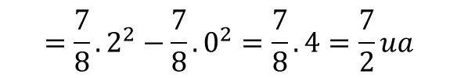
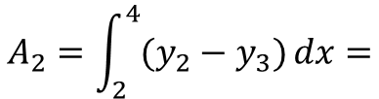
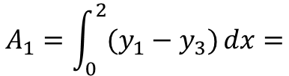
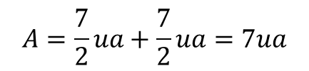
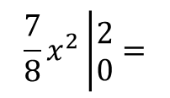
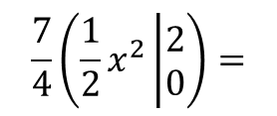
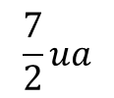
$$A_{1}=\int_{0}^{2}{(y_{1}−y_{3})}dx=$$
$$\int_{0}^{2}{(2x−\frac{1}{4}x)}dx=$$
$$\int_{0}^{2}{\frac{7}{4}x}dx=$$
$$\frac{7}{4}\int_{0}^{2}{x}dx=$$
$$\frac{7}{4}\left(\frac{1}{2}x^{2}\left|\begin{matrix}2 \\ 0\end{matrix}\right.\right)=$$
$$\frac{7}{8}x^{2}\left|\begin{matrix}2 \\ 0\end{matrix}\right.=$$
$$=\frac{7}{8}.2^{2}−\frac{7}{8}.0^{2}=\frac{7}{8}.4=\frac{7}{2}ua$$
$$A_{2}=\int_{2}^{4}{(y_{2}−y_{3})}dx=$$
$$\int_{2}^{4}{(−\frac{3}{2}x+7−\frac{1}{4}x)}dx=$$
$$\int_{2}^{4}{\left(−\frac{7}{4}x+7\right)}dx=$$
$$\left(−\frac{7}{8}x^{2}+7\left|\begin{matrix}4 \\ 2\end{matrix}\right.\right)=$$
$$\frac{7}{2}ua$$
$$A=\frac{7}{2}ua+\frac{7}{2}ua=7ua$$

Slide 5
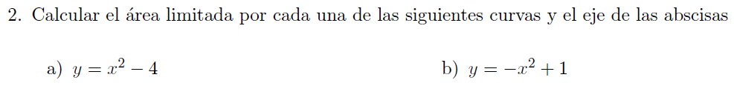

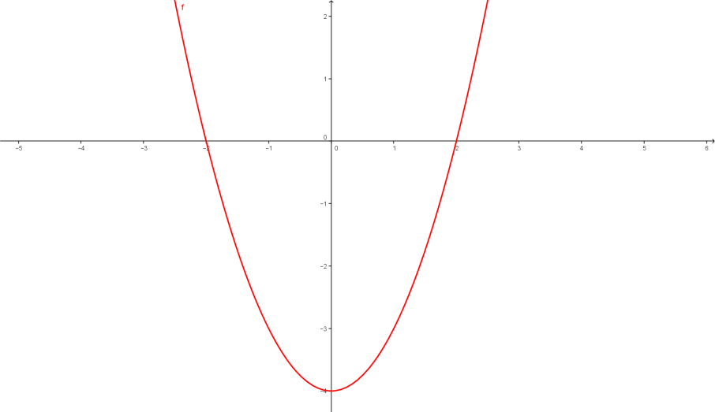
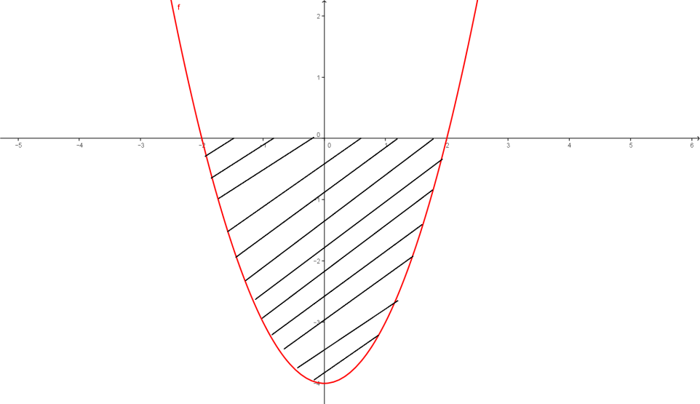
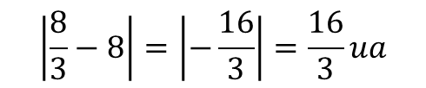
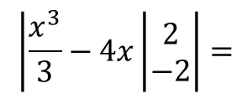
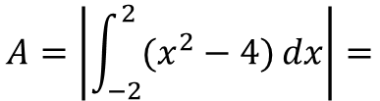
$$A=\left|\int_{−2}^{2}{(x^{2}−4)}dx\right|=$$
$$\left|\frac{x^{3}}{3}−4x\left|\begin{matrix}2 \\ −2\end{matrix}\right.\right|=$$
$$\left|\frac{8}{3}−8\right|=\left|−\frac{16}{3}\right|=\frac{16}{3}ua$$

Slide 6
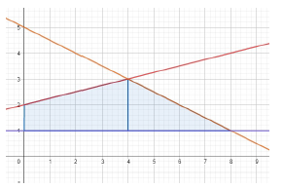



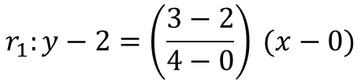
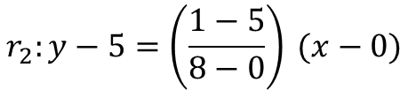
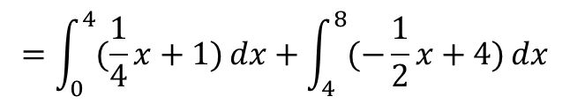
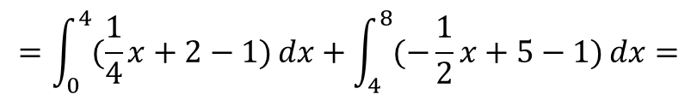



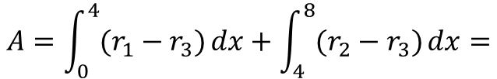




$$r_{1}:$$
$$P_{1}=(0,2)$$
$$P_{2}=(4,3)$$
$$r_{1}:y−2=\left(\frac{3−2}{4−0}\right) (x−0)$$
$$r_{1}:y=\frac{1}{4}x+2$$
$$r_{2}:$$
$$P_{1}=(0,5)$$
$$P_{2}=(8,1)$$
$$A=\int_{0}^{4}{(r_{1}−r_{3})}dx+\int_{4}^{8}{(r_{2}−r_{3})}dx=$$
$$r_{2}:y−5=\left(\frac{1−5}{8−0}\right) (x−0)$$
$$=\int_{0}^{4}{(\frac{1}{4}x+2−1)}dx+\int_{4}^{8}{(−\frac{1}{2}x+5−1)}dx=$$
$$r_{2}:y=−\frac{1}{2}x+5$$
$$=\int_{0}^{4}{(\frac{1}{4}x+1)}dx+\int_{4}^{8}{(−\frac{1}{2}x+4)}dx$$
$$r_{3}:y=1$$

Slide 7

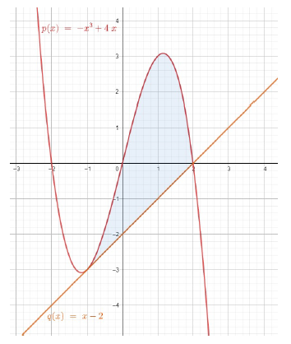

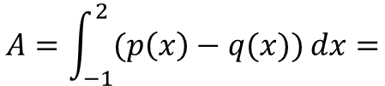


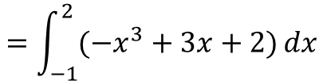

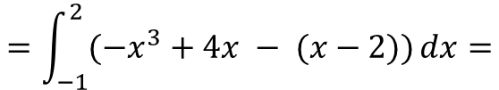


Determinamos analíticamente la intersección de las funciones
$$p\left(x\right)=q(x)$$
$$−x^{3}+4x=x−2$$
$$x^{3}−4x+x−2=0$$
$$x^{3}−3x−2=0$$
$$x_{1}=−1$$
$$x_{2}=2$$
$$A=\int_{−1}^{2}{(p\left(x\right)−q(x))}dx=$$
$$=\int_{−1}^{2}{(−x^{3}+4x − (x−2))}dx=$$
$$=\int_{−1}^{2}{(−x^{3}+3x+2)}dx$$

Slide 8

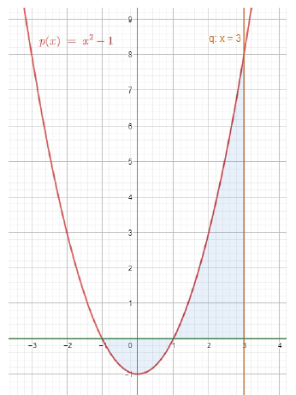



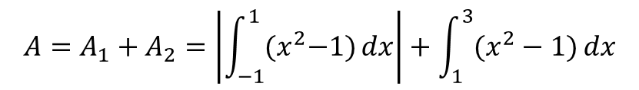

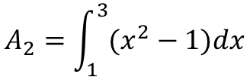


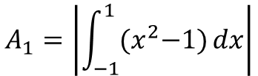



$p\left(x\right)=x^{2}−1$
$$q:x=3$$
Determinamos analíticamente la intersección con eje x
$$p\left(x\right)=x^{2}−1=0$$
$$x^{2}−1=0$$
$$x_{1}=−1$$
$$x_{2}=1$$
$$A=A_{1}+A_{2}$$
$$A_{1}=\left|\int_{−1}^{1}{{(x}^{2}−1)}dx\right|$$
$$A_{2}$$
$$A_{2}=\int_{1}^{3}{(x^{2}−1})dx$$
$$A_{1}$$
$$A=A_{1}+A_{2}=\left|\int_{−1}^{1}{{(x}^{2}−1)}dx\right|+\int_{1}^{3}{(x^{2}−1)}dx$$

